Slide 1

What is Sociology?
SHIRIN TUMENBAEVA
GENERAL SOCIOLOGY

Slide 2
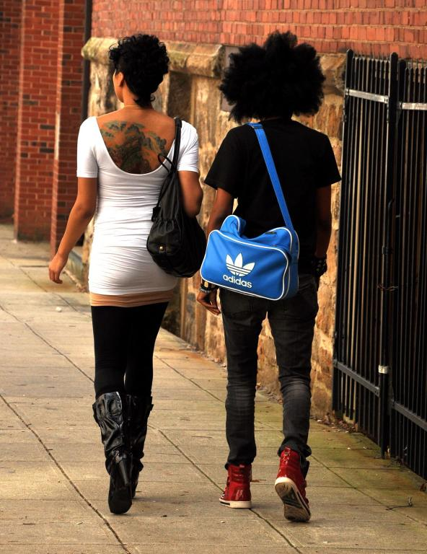
When you walk down a street do you sometimes wonder what is going on inside the buildings you pass?
Notes:
Recall that sociologist Peter Berger uses this analogy to introduce the nature of the sociological consciousness in his classic book, Invitation to Sociology.
Photo credit: Lisa Southwick

Slide 3
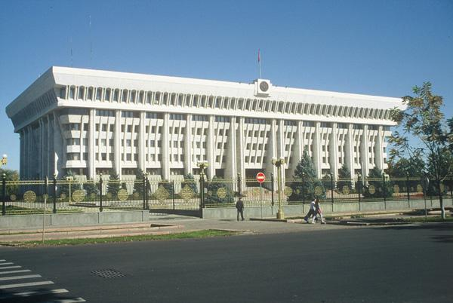
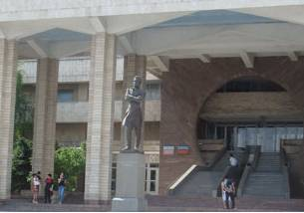
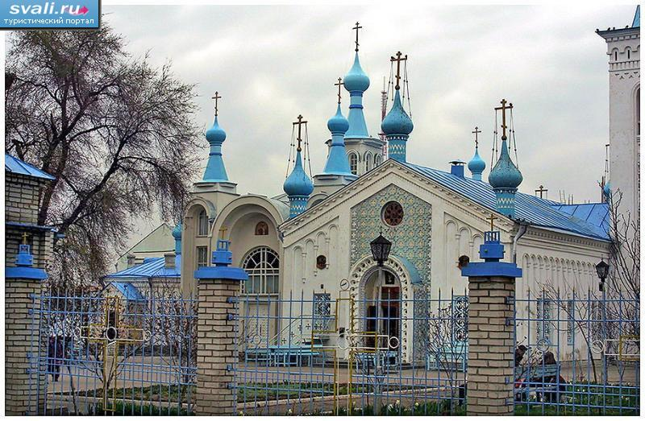
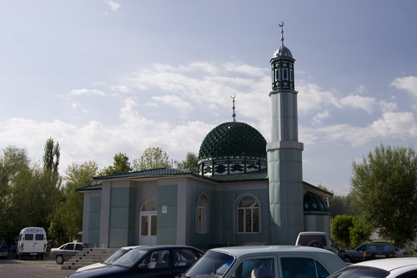
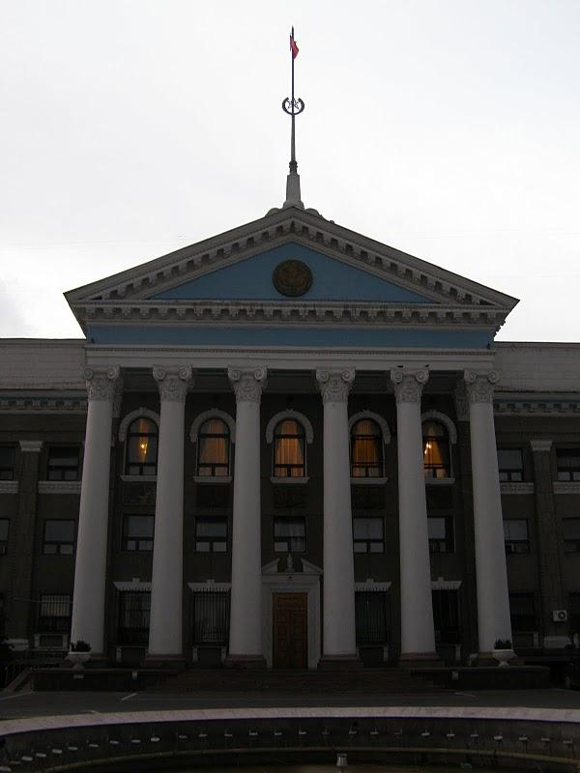
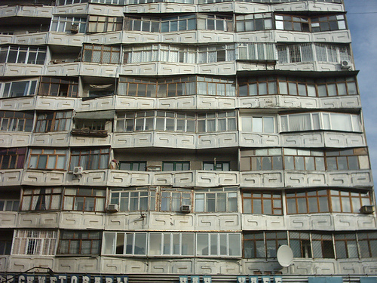
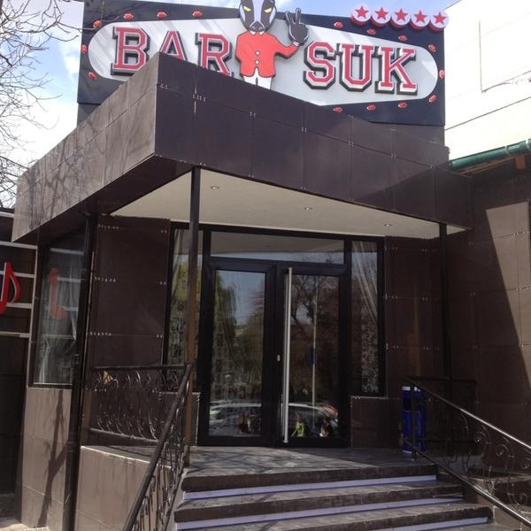
Are you interested in what is going on inside any of these buildings?
Notes:
You might want to add your own images of buildings. But the purpose is just to tweak student curiosity. Have you ever wondered what goes on behind closed doors? If students have no interest perhaps sociology is not the discipline for them. You might ask students if they have ever been inside such places—a pay-day loan operation, a for-profit university, a solar-powered business? Any insights about what goes on? But really the purpose on the first day is, not too overload students, but just get them thinking about sociology and raise curiosity.
Photo credits: Chris Caldeira

Slide 4
The drive to understand how and why these structures were built, to go inside and learn more about the human activities that take place inside, captures the sociological consciousness.

Slide 5
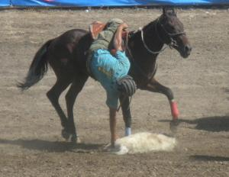
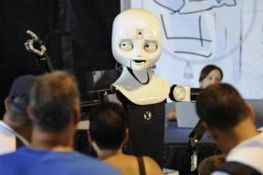
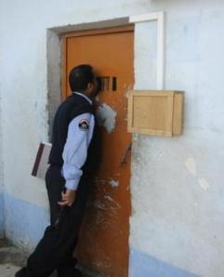
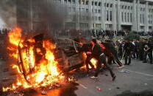
Sociology is the scientific study of human activity.
Notes:
These are just four examples of the endless variety of human activities that sociologists study. For this slide the definition of human activity is very broad—a more specific definition of human activity follows.
Background to Photos
(Top left) People interacting with mobile, dexterous, social robot—the group is focused on establishing whether teams of humans and autonomous (robotic) systems can communicate clearly, collaborate to solve a problem and interact via face-to-face and remotely.
Photo credit: John F. Williams
http://www.defenseimagery.mil/imagery.html#a=search&s=robot&t=0&p=9&guid=8241a8b756b568f9e5841aa30364ac1c09a5cf39
(Bottom left) A guard looks inside a prison cell
Photo credit: Senior Airman Eric Harris
http://www.defenseimagery.mil/imagery.html#a=search&s=prison%20cells&t=0&p=3&guid=261dcf2f92ca67e7dd083886c13f5de8b242b7f6
(Top right) University of Louisville and Oregon State University football game taking place in a packed stadium
Photo credit: Kirby Rider http://www.defenseimagery.mil/imagery.html#a=search&s=stadium&t=0&p=19&guid=f68a1dd09964057c32bebd06322914af3b4e49cd
(Bottom right): Drivers picking up fast food orders.
Photo credit: Lisa Southwick

Slide 6

Sociology Disciplines

Slide 7
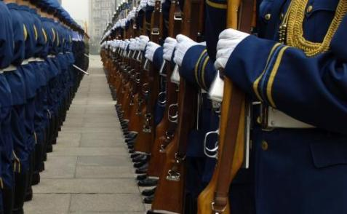
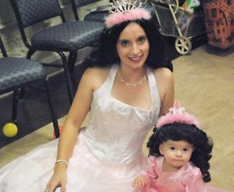
Human activity—the things people ….
. . . do with, to and for one another
. . . think and do as a result of others’ influence
Notes:
The human activities sociologists study can include governments supporting militaries for defensive and offensive purposes. It can be activities that influence little girls to think of themselves as princesses and to enjoy (or even reject) dressing up as such.
Photo Credit: Mr. Mark Weiman, http://www.army.mil/media/157103
Photo credit: STAFF SGT. D. MYLES CULLEN
http://www.defenseimagery.mil/imagery.html#a=search&s=chinese%20honor%20guard&t=0&p=2&guid=a7ce3f513ce30d222909207b41816dd1514eaa56

Slide 8
Sociology is systematic study of social life and behavior, especially in relation to social systems – how they work, how they change, the consequences they produce, and their complex relation to people’s lives (Allan G. Johnson)

Slide 9
Social System
A social system is a set of elements or parts, related to one another through some kind of interdependency, that can thought of as a whole
Ex.: society, family, army, university, etc.
Each exists only in relations to the others

Slide 10
1
Social forces are anything humans create that influences or pressures people to interact, behave, respond, or think in certain ways.
Language
Laws
Inventions
Ideas
Meanings
Social Structure
Notes:
The intro class is really a course about social forces that shape human activities … Again at this point I try not to be too technical—but give some hints of things—in bold letters (e.g., language, laws)—we will be studying that qualify as social forces. You might want to add “social forces” that best resonate with you. Feel free to change— you know your student body best and the kinds of examples that appeal to them.

Slide 11
How do sociologists think about
any human activity?
Social forces
Human activity (the way it is organized)
Opportunities
Disadvantages
Sense of self
Relationships with others and larger environment
Notes:
This chart represents the basic model for what sociologists study.
In the slides that follow we elaborate on this model. But the basic model is that sociologists seek to identify the social forces that shape the organization of human activity and they also seek to understand the consequences of the way human activity is organized—consequences related (1) to opportunities and disadvantages some people experience (and not others), (2) to the sense of self; and (3) to relationships with others and the environment.

Slide 12
Social Force: Mobile Phone
Notes:
Let’s start with the concept social forces

Slide 13
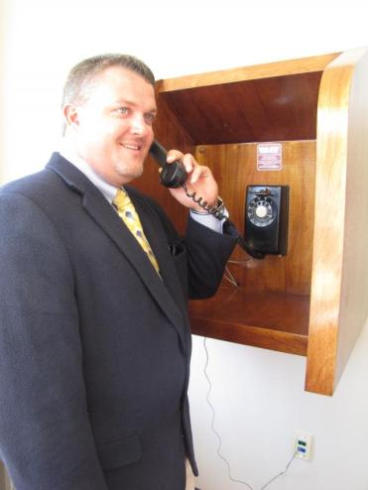
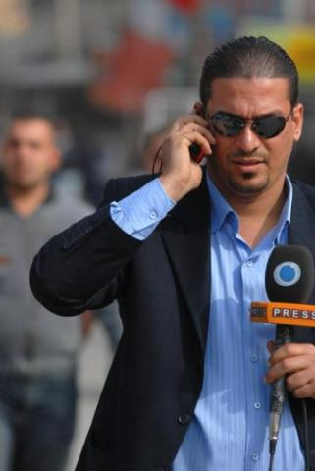
Example of an “invention” as a social force: the mobile phone
Notes:
Photo credit: (left) Kari Hawkins, USAG Redstone, http://www.army.mil/media/152679
(right) Department of Defense

Slide 14
Revolutionary feature of the mobile phone:It frees people from being in a specific physical space when they communicate with others.

Slide 15
Social Force: Mobile Phone
Human activity (the way it is organized)
Notes:
The next part of the model: sociologists identify the social forces that affect the way human activity is organized. Recall definition of human activity—the things that (1) people do with, to and for one another AND that (2) they think and do as a result of others’ influence

Slide 16
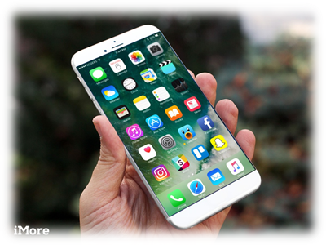
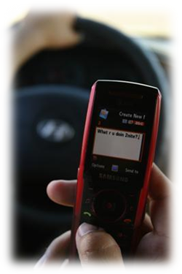
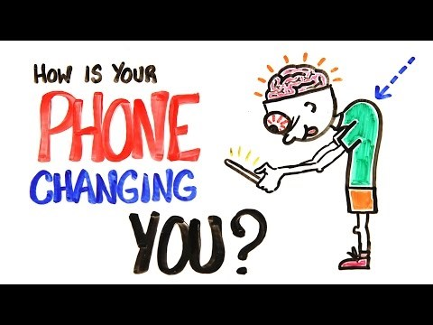

What kinds of human activities have changed as a result of the mobile phone?
Notes:
Students should have lots of examples—but certainly the mobile phone has changed the human activity of driving, if only that it is yet another distraction. Note that ultimately driving is an human activity that connects humans to one another—whether it be consumers to sellers, family members, friends, and so on. As we drive, we can now let people know we are on the way, that we are within a minute of arrival, and where we are. We can report an emergency as we see it or call for help on the spot.
Photo credit: Stephanie Ingersoll,
http://www.marines.mil/Pages/PhotoDetails.aspx?ItemUrl=http://www.marines.mil/unit/basecamppendleton/PublishingImages/20081007-M-3360I-001.jpg

Slide 17
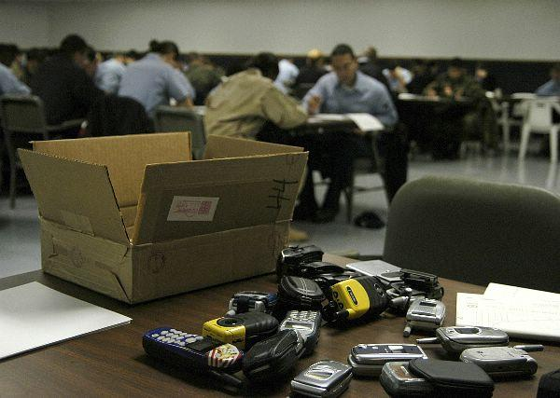
How has the mobile phone changed the way the classroom is organized?
Notes:
One way is that many instructors now police the use of mobile phones, confiscate them when students take tests, and so on. Some instructors allow students with smart phones to use them during class to look up useful information. Some students use smart phones to check whether what an instructor says is “correct.”
Photo credit: Department of Defense

Slide 18
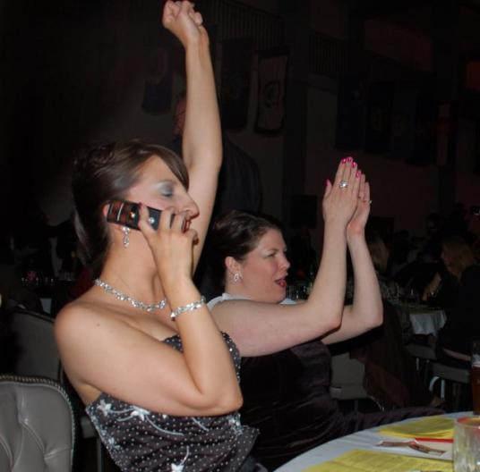
How has the mobile phone changed the way we relate to others at public events?
Notes:
What does it mean that a person can be potentially interrupted by a call during any event? Even if the person doesn’t answer the call or text, they are often aware that someone has texted or called, and just that awareness may distract them from full concentration or participation.
Photo credit: Sarah J. Schmidt, http://www.army.mil/media/61107

Slide 19
Human activity (the way it is organized)
Opportunities
Disadvantages
Sense of self
Relationships with others and environment
Notes:
Part 3 of the mode—the effects of human activity (the way it is organized)

Slide 20
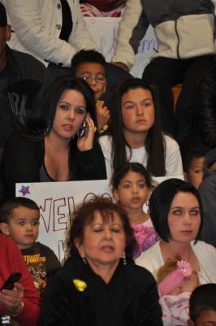
What opportunities and disadvantages come with the mobile phone?
Immediate access to others (not present), no matter the setting
May not be able to fully engage in an activity
Notes:
Photo Credit: (left) Charles Melton, http://www.army.mil/media/192405;
(right) Sarah J. Schmidt http://www.army.mil/media/61107

Slide 21
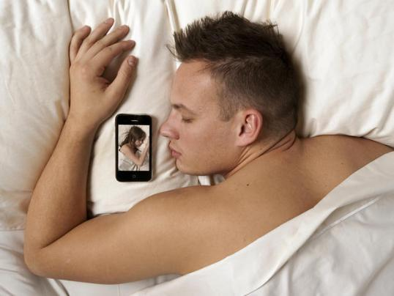
How is sense of self shaped by the mobile phone?
Notes:
How is sense of self affected by the fact that we have partners, friends, employers who can contact us 24/7 and who may expect an immediate response. As one example, during a visit (check up) with my physician, his mobile phone vibrated. He looked at me and said “there are two people who can interrupt me at any time and I will answer the phone– my wife and my mother.” He left the room to talk and came back about five minutes later.
Photo credit: Department of Defense http://www.defenseimagery.mil/imagery.html#a=search&s=cell%20phone&t=0&p=5&guid=cb0424b1477d94933da159e810137286b5ab4cd0

Slide 22
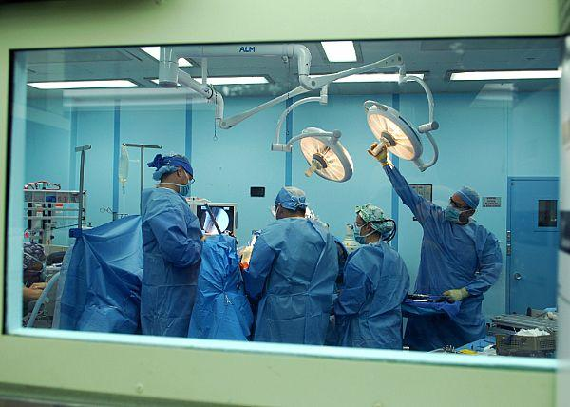
What about relationships with others and the surrounding environment?
Notes:
In a survey of 439 doctors who perform cardiopulmonary bypass (CPB) surgery 55.6% reported using their mobile phones while performing surgery to send or check text messages, access e-mail, check postings on social networking sites or otherwise use the internet. For more on this check out
Richtel, Matt. 2011. “As Doctors Use More Devices, Potential for Distraction Grows.” New York Times (December 14) http://www.nytimes.com/2011/12/15/health/as-doctors-use-more-devices-potential-for-distraction-grows.html?pagewanted=2&partner=rss&emc=rss
and
Smith. T, E. Darling, and B. Searles. 2011. “2010 Survey on Cell Phone Use While Performing Cardiopulmonary Bypass.” Presented at the 32nd Annual Seminar of The American Academy of Cardiovascular Perfusion, Reno, Nevada, 27-30, January, 2011. http://prf.sagepub.com/content/26/5/375.abstract
Photo credit: Mass Communication Specialist 2nd Class Eddie Harrison, http://www.navy.mil/view_single.asp?id=87445

Slide 23
Sociology offers a framework for studying human activity
It offers
questions to guide analysis
vocabulary for answering those questions
Notes:
Notice that questions have guided our analysis of the mobile phone. It is the questions that sociologists ask and the vocabulary we draw upon to answer those questions that makes us “sociologists.”

Slide 24
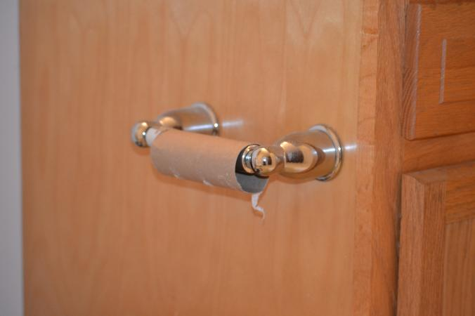
What meaning do you assign to this empty roll of toilet tissue?
Notes:
Again, this is the first day of class and the goal is to introduce students to kinds of questions that guide sociological thought and analysis. In time (over the course of the semester) students will learn that there is pattern to the questions sociologists ask.
Photo credit: Missy Gish

Slide 25
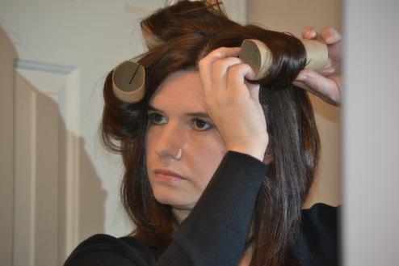
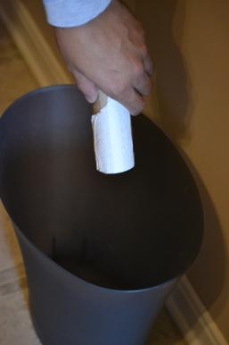
Which photo best reflects the meaning you assign to the empty roll of toilet tissue?
Notes:
Photo credit: Missy Gish

Slide 26


Cuba
U.S.
Notes:
For the most part, in the United States people are encouraged to throw away things without thinking of other uses to which they might be put. Americans are not encouraged, for example, to think about how they might use an empty toilet paper roll. People living in Cuba, on the other hand, are encouraged to think about such things—empty toilet paper rolls can function as a hair curlers.
For more on Cuba as a country of people who are revolutionary in their ability to recycle see Earth Times, “Cuba! Revolutionary Recyclers”
http://www.earthtimes.org/going-green/cuba-revolutionary-recyclers/981/
Photo credits: Missy Gish

Slide 27
What social forces contribute to different ways of thinking about and responding to empty toilet paper rolls?
Resource-rich country
Consumption-oriented culture (capitalism)
Ability to access resources from foreign sources
Resource-poor country
Thrift-oriented culture
U.S. embargo since 1960
Collapse of Soviet Union
Notes:
These photos prompt us to ask: how it is that Cuba became a nation of recyclers? In 1960, after Fidel Castro seized U.S. assets, and subsequently declared Cuba a socialist country, the United States imposed an economic embargo on Cuba and broke diplomatic relations. Cuba formed close ties with the Soviet Union, receiving $4-$6 billion in foreign aid each year from its ally. When the Soviet Union collapsed in 1989, Cuba lost an important revenue source. This loss, in conjunction with the 50+ year embargo, has made economic hardship a way of life for the Cuban people—a hardship that has supported the creation of a culture where almost nothing is thrown away.
Photo credits: Missy Gish

Slide 28
How does attitude toward resources and corresponding behavior affect sense of self?
Sense of self revolves around ingenuity
Sense of self revolves around consumption
Notes:
A word of caution—students shouldn’t come away thinking things like “I wish I lived in Cuba” or “I am glad I live in the U.S.” Too simplistic. Many Cubans would likely emigrate to U.S. if given the opportunity. And many Americans certainly wish that an “ability to buy things” was not a key measure of personal success. As people in the United States become more aware of carbon footprints, we can perhaps learn from the Cuban people ways to reduce our carbon footprint. We can certainly appreciate/admire Cuban “ingenuity” in finding uses for things most in the United States would throw away.
Photo credits: Missy Gish

Slide 29
In this course you will learn…
a pattern to the questions sociologists ask
a vocabulary that helps to answer the questions asked

Slide 30
"The first wisdom of
sociology
–things are not what they seem."
Peter Berger

Slide 31
For Seminar
Chapter I (Johnson)
What is sociological imagination?
First concepts and ideas of Sociology
Society and Group?

